Slide 1
PCO003 – Operational Systems
Rodrigo Maximiano Antunes de Almeida
rmaalmeida@gmail.com
@rmaalmeida
Universidade Federal de Itajubá

Slide 2
Review

Slide 3
Exercise
Implement priority selection inside the kernel
Lower number -> lower priority
Must keep (soft) real time scheduling
Processes (with priorities)
4 – keypad debounce
3 – increment/decrement clock
2 – display update
1 – clock count (ssdDigit)

Slide 4
Kernel
Its organization, so far.

Slide 6
ARCH
Process
Pool
0
1
2
3
4
5
P1
Sched
Kernel [kernelLoop()]
Tick
ptrFunc
period
time
P2
Main()
void *pt(void)
uC
Interrupt
Timer
UART
CCP
IO
DMA
ADC
PWM

Slide 7
ARCH
Process
Pool
0
1
2
3
4
5
P1
Kernel [kernelLoop()]
Tick
P2
Main()
ddCtr
IO
Timer
UART
ADC
PWM
uC
Interrupt
Timer
UART
CCP
IO
DMA
ADC
PWM

Slide 8
Drivers

Slide 9
void pointers

Slide 10
Void pointers
Points to a memory region without specifying the type.
Can not be used without casting.
Abstraction that allows the programmer to pass the parameter of different types to the same function.
A function that receives how to know how to handle each type.

Slide 11
Void pointers
char *name = "Paulo";
double weight = 87.5;
unsigned int children = 3;
void main (void){
//não confundir com printf
print(0, name);
print(1, &weight);
print(2, &children);
}

Slide 12
Void pointers
void print(int option; void *parameter){
switch(option){
case 0:
printf("%s",(char*)parameter);
break;
case 1:
printf("%f",*((double*)parameter));
break;
case 2:
printf("%d",*((unsigned int*)parameter));
break;
}
}

Slide 13
Driver

Slide 14
Driver
What is a driver?
An interface layer that translate hardware to software
It have two requirements
First: It is dependent on the microcontroller, the attached peripherals and the connections between them.
Second: Need to comply with the built-in standard from the operational system

Slide 15
How can I develop my driver?
First: know your hardware
Which features from the microcontroller are needed?
How the external peripheral is connected?
Are there any software/communication routines required?

Slide 16
Developing my driver (1)
Example:
LCD Display:
16 columns X 2 lines
Compatible with HD44780 (Hitachi)
NEO201
8 bit connection (data)
Direct access to EN, RS e RW (control)
PIC18F4520
Using both port D (data) and port E (control)
Initialization routines

Slide 17
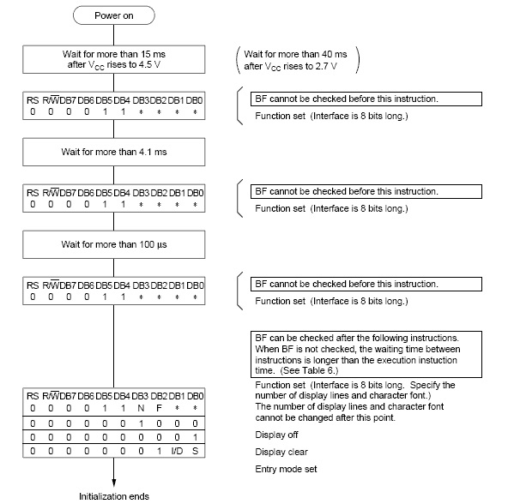
LCD initialization routine

Slide 18
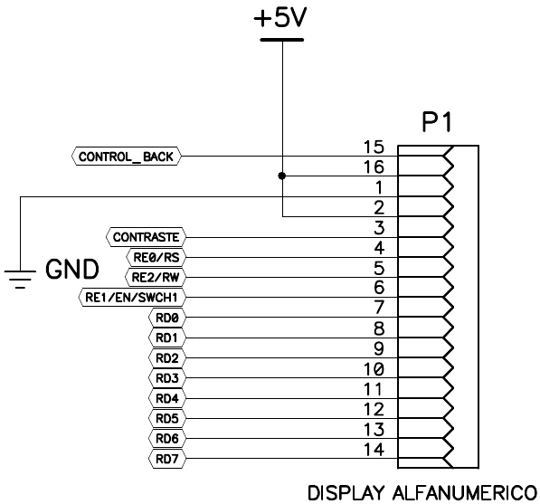
Schematics LCD - PIC

Slide 19
Basic communication
void lcdData(unsigned char valor){
BitSet(PORTE,RS); //data
BitClr(PORTE,RW); //write
PORTD = valor;
BitSet(PORTE,EN); //enable pulse
BitClr(PORTE,EN);
BitClr(PORTE,RS); //avoid problems with 7 seg disp
Delay40us();
}

Slide 20
Basic communication
void lcdInit(void){
// lcd init 10ms
Delay2ms();
Delay2ms();
Delay2ms();
Delay2ms();
Delay2ms();
//pin directions
BitClr(TRISE,RS); //RS
BitClr(TRISE,EN); //EN
BitClr(TRISE,RW); //RW
TRISD = 0x00; //data
ADCON1 = 0b00001110; //Analog/digital config
lcdCommand(0x38); //8bits, 2 lines, 5x8
lcdCommand(0x06); //incremental mode
lcdCommand(0x0F); //display, cursor , blink on
}

Slide 21
How can I develop my driver?
Second: know your operational system
Is there any standard on function parameters?
Which structures and information do I need to provide to the operational system
How the OS will pass information for me?

Slide 22
Talking with any type of driver
Parameters problem
The kernel must be able to communicate in the same way with all drivers
Each function in each driver have different types and quantities of parameters
Solution
Pointer to void

Slide 23
Void pointers
Points to a memory region without specifying the type.
Can not be used without casting.
Abstraction that allows the programmer to pass parameters of different types to the same function.
The function that receives them must know how to handle each type.

Slide 24
Void pointers
char *name = "Paulo";
double weight = 61.5;
unsigned int children = 3;
void main (void){
//it is not printf!!!!
print(0, name);
print(1, &weight);
print(2, &children);
}

Slide 25
Void pointers
void print(int option; void *parameter){
switch(option){
case 0:
printf("%s",(char*)parameter);
break;
case 1:
printf("%f",*((double*)parameter));
break;
case 2:
printf("%d",*((unsigned int*)parameter));
break;
}
}

Slide 26
The standard
//ptr. de func. para uma função do driver
typedef char(*ptrFuncDrv)(void *parameters);
//estrutura do driver
typedef struct {
char id;
ptrFuncDrv *funcoes;
ptrFuncDrv initFunc;
} driver;
driver
+drv_id: char
+functions: ptrFuncDrv[ ]
+drv_init: ptrFuncDrv

Slide 27
The standard
#ifndef DD_TYPES_H
#define DD_TYPES_H
//Device Drivers Types (dd_types.h)
//ptr. de func. para uma função do driver
typedef char(*ptrFuncDrv)(void *parameters);
//estrutura do driver
typedef struct {
char id;
ptrFuncDrv *funcoes;
ptrFuncDrv initFunc;
} driver;
//função de retorno do driver
typedef driver* (*ptrGetDrv)(void);
#endif /* DD_TYPES_H */

Slide 28
Driver example

Slide 29
Driver example
#ifndef drvGeneric_h
#define drvGeneric_h
#include "dd_types.h"
//lista de funções do driver
enum {
LED_SET,LED_FLIP, LED_END
};
//função de acesso ao driver
driver* getGenericDriver(void);
#endif // drvGenerico_h

Slide 30
Driver example
#include "kernel.h"
#include "pic18f4520.h"
#include "drvGeneric.h“
static driver meu_cartao;
static ptrFuncDrv my_funcs[LED_END];

Slide 31
Driver example
char changePORTD(void *parameters) {
PORTD = (char) parameters;
return SUCCESS;
}
char inverte(void * parameters){
PORTD = ~PORTD;
return SUCCESS;
}
char initGenerico(void *parameters) {
TRISD = 0x00; PORTD = 0xFF;
meu_cartao.id = (char) parameters;
return SUCCESS;
}

Slide 32
Driver example
driver* getGenericDriver(void) {
meu_cartao.initFunc = initGenerico;
my_funcs[LED_SET] = changePORTD;
my_funcs[LED_FLIP] = inverte;
meu_cartao.funcoes = my_funcs;
return & meu_cartao;
}

Slide 33
Device Driver Controller

Slide 34
Architecture (so far)
Process
Pool
0
1
2
3
4
5
P1
Kernel [kernelLoop()]
Tick
P2
ddCtr
Main()
IO
Timer
UART
ADC
PWM
uC
Interrupt
Timer
UART
CCP
IO
DMA
ADC
PWM

Slide 35
Device Driver Controller

Slide 36
Device Driver Controller
Used as an interface layer between the kernel and the drivers
Can “discover” all available drivers (statically or dynamically)
Store information about all loaded drivers
Responsible to interpret the messages received from the kernel

Slide 37
Device Driver Controller
The controller implementation has only 2 functions:
One for initializing a driver
In addition to initialization must provide an ID for the driver.
One to go through the application commands for the drivers

Slide 38
Device Driver Controller
char callDriver(char drv_id, char func_id, void *p) {
char i;
for (i = 0; i < dLoaded; i++) {
//find the right driver
if (drv_id == drivers[i]->id) {
return drivers[i]->funcoes[func_id](p);
}
}
return DRV_FUNC_NOT_FOUND;
}

Slide 39
Device Driver Controller
static driver* drivers[QNTD_DRV];
static char dLoaded;
char initCtrDrv(void) {
dLoaded = 0;
}
char initDriver(char newDriver) {
char resp = FAIL;
if(dLoaded < QNTD_DRV) {
//get driver struct
drivers[dLoaded] = drvGetFunc[newDriver]();
//should test if driver was loaded correcly
resp = drivers[dLoaded]->initFunc(newDriver);
dLoaded++;
}
return resp;
}

Slide 40
Device Driver Controller
To gain access to all drivers, it is necessary for the controller to obtain the address of a driver type structure.
Statically:
a list is built with functions that return this structure.
Dynamically:
this structure is received via serial communication and the address where the data was saved is returned.

Slide 41
Device Driver Controller
The drivers functions which return the driver’s structure, are presented to the controller in the header file.
The controller header includes each header from the drivers it knowns at run time.
A list of the functions is assembled together with a descriptive enumeration of the same list.

Slide 42
Device Driver Controller
#ifndef ctrdrv_h
#define ctrdrv_h
#define QNTD_DRV 20
char initCtrDrv(void);
char callDriver(char drv_id, char func_id, void *parameters);
char initDriver(char newDriver);
// Drivers conhecidos estáticamente
enum {
DRV_END /*DRV_END must always be the last*/
};
static ptrGetDrv drvGetFunc[DRV_END] = {
};
#endif // ctrdrv_h

Slide 43
Device Driver Controller
//ddCtr.h
#include "drvGenerico.h"
#include "drvInterrupt.h"
#include "drvTimer.h"
enum {
DRV_GEN, /*1st driver*/
DRV_INTERRUPT, /*2nd driver*/
DRV_TIMER, /*3rd driver*/
DRV_END /*DRV_END must always be the last*/
};
//the functions to get the drivers should be put in the same order as in the enum
static ptrGetDrv drvGetFunc[DRV_END] = {
getGenericoDriver, /*1st driver*/
getInterruptDriver, /*2nd driver*/
getTimerDriver /*3rd driver*/
};

Slide 44
Device driver utilization
void main(void) {
//system initialization
kernelInitialization();
initDriver(DRV_LCD);
callDriver(DRV_LCD, LCD_CHAR, 'U');
callDriver(DRV_LCD, LCD_CHAR, 'N');
callDriver(DRV_LCD, LCD_CHAR, 'I');
callDriver(DRV_LCD, LCD_CHAR, 'F');
callDriver(DRV_LCD, LCD_CHAR, 'E');
callDriver(DRV_LCD, LCD_CHAR, 'I');
callDriver(DRV_LCD, LCD_CHAR, '@');
callDriver(DRV_LCD, LCD_CHAR, 'S');
callDriver(DRV_LCD, LCD_CHAR, '0');
callDriver(DRV_LCD, LCD_CHAR, '3');
}

Slide 45
Where are the defines?

Slide 46
Where are the defines?
In order to simplify the design, each driver build its function enum
The controller builds a driver enum
enum {
LCD_COMMAND, LCD_CHAR, LCD_INTEGER, LCD_END
};
enum {
DRV_INTERRUPT, DRV_TIMER, DRV_LCD, DRV_END
};

Slide 47
Architecture (so far)
P1
P2
Process
Pool
0
1
2
3
ddController
ptrGetDriver()
dLoaded
Tick
Kernel [kernelLoop()]
IO
&IO
Timer
UART
&UART
ADC
&ADC
Main()
PWM
uC
Interrupt
Timer
UART
CCP
IO
DMA
ADC
PWM

Slide 48
Abstraction layers

Slide 49
Abstraction layer
“In computing, an abstraction layer or abstraction level is a way of hiding the working details of a subsystem, allowing the separation of concerns to facilitate interoperability and platform independence.”
https://en.wikipedia.org/wiki/Abstraction_layer

Slide 50
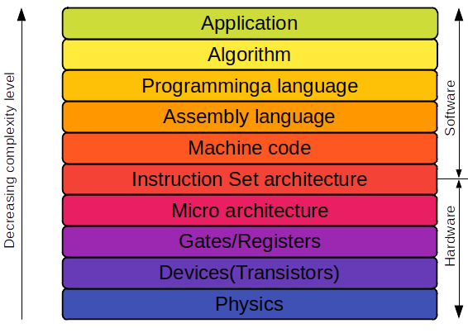
Abstraction layer
https://scimos.com/2020/07/07/layers-of-abstraction/

Slide 51
IAL
Working with interrupts

Slide 52
Interrupt Abstract Layer - IAL
One type of hardware common to almost every microcontroller is the interrupt device.
This device pauses the processor when there is an interrupt call.
It then checks the source of the call and, after saving the CPU variables on the stack, starts executing from a predefined address.

Slide 53
Interrupt Abstract Layer - IAL
Interrupts are closely related to hardware
Each architecture AND compiler pose a different programming approach
How to hide this from programmer?
//SDCC compiler way
void isr(void) interrupt 1{
thisInterrupt();
}
//C18 compiler way
void isr (void){
thisInterrupt();
}
#pragma code highvector=0x08
void highvector(void){
_asm goto isr _endasm
}
#pragma code

Slide 54
Interrupt Abstract Layer - IAL
In order to simplify this device from the point of view of the software it is common to create a driver to manage the device.
This driver will receive the address of functions that will be executed when a certain interruption happens.
You need a function to receive the address and a variable to store it internally

Slide 55
Interrupt Abstract Layer - IAL
//Inside drvInterrupt.c
//defining the pointer to use in ISR callback
typedef void (*intFunc)(void);
//store the pointer to ISR here
static intFunc thisInterrupt;
//Set interrupt function to be called
char setInterruptFunc(void *parameters) {
thisInterrupt = (intFunc) parameters;
return SUCESS;
}

Slide 56
Interrupt Abstract Layer - IAL
The IAL facilitates the use of interruptions by the programmer
The desired driver is initialized
The interrupt driver is initialized
The desired function is set

Slide 57
Interrupt Abstract Layer - IAL
//Interrupt function set without knowing compiler issues
void timerISR(void) {
callDriver(DRV_TIMER, TMR_RESET, 1000);
kernelClock();
}
void main (void){
kernelInit();
initDriver(DRV_TIMER);
initDriver(DRV_INTERRUPT);
callDriver(DRV_TIMER, TMR_START, 0);
callDriver(DRV_TIMER, TMR_INT_EN, 0);
callDriver(DRV_INTERRUPT, INT_TIMER_SET,
(void*)timerISR);
callDriver(DRV_INTERRUPT, INT_ENABLE, 0);
kernelLoop();
}

Slide 58
Driver Callback

Slide 59
Driver Callback
How to make efficient use of CPU peripherals without using pooling or hard-coding the interrupts?

Slide 60
Calback functions

Slide 61
Calback functions
Callback functions resemble events in high level programming
e.g.: When the mouse clicks in the button X, please call function Y.
The desired hardware must be able to rise an interrupt
Part of the work is done under interrupt context, preferable the faster part

Slide 62
Calback functions
In the callback process there are two separate parts that must be executed sequentially.
The first is the code that runs inside the interrupt. It should be fast and use few resources. Usually only the data or information generated by the interrupt is saved and its processing is delayed at this time
The second is the callback process, now run by the kernel can take longer without disturbing the system timing.

Slide 63
Calback functions
Kernel
Main
Callback
Driver
Interrupt
Process
Process
Layer
KernelInit: InitDrv()
ISRsetup
(&callbackPtr)
KernelLoop:
MainProc.()
DataRequest (&callbackProc)
HW interrupt
isrPtr()
kernelAddProc(&callback)
KernelLoop: CallbackProc()

Slide 64
Calback functions
//********** Excerpt from drvAdc.c **********
// called from setup time to enable ADC interrupt
// and setup ADC ISR callback
char enableAdcInterrup(void* parameters){
callDriver(DRV_INTERRUPT,INT_ADC_SET,(void*)adcISR);
BitClr(PIR1,6);
return FIM_OK;
}
//********** Excerpt from drvInterrupt.c **********
// store the pointer to the interrupt function
typedef void (*intFunc)(void);
static intFunc adcInterrupt;
// function to set ADC ISR callback for latter use
char setAdcInt(void *parameters) {
adcInterrupt = (intFunc)parameters;
return FIM_OK;
}

Slide 65
Calback functions
//********** Excerpt from main.c **********
// Process called by the kernel
char adc_func(void) {
//creating callback process
static process proc_adc_callback = {adc_callback, 0, 0};
callDriver(DRV_ADC,ADC_START,&proc_adc_callback);
return REPEAT;
}
//********** Excerpt from drvAdc.c **********
//function called by the process adc_func (via drv controller)
char startConversion(void* parameters){
callBack = parameters;
ADCON0 |= 0b00000010; //start conversion
return SUCCESS;
}

Slide 66
Calback functions
//********** Excerpt from drvInterrupt.c **********
//interrupt function
void isr(void) interrupt 1 {
if (BitTst(INTCON, 2)) { //Timer overflow
}
if (BitTst(PIR1, 6)) { //ADC conversion finished
//calling ISR callback stored
adcInterrupt();
}
}
//********** Excerpt from drvAdc.c **********
//ADC ISR callback function
void adcISR(void){
value = ADRESH;
value <<= 8;
value += ADRESL;
BitClr(PIR1,6);
kernelAddProc(callBack);
}

Slide 67
Calback functions
//********** Excerpt from main.c **********
//callback function started from the kernel
char adc_callback(void) {
unsigned int resp;
//getting the converted value
callDriver(DRV_ADC,ADC_LAST_VALUE,&resp);
//changing line and printing on LCD
callDriver(DRV_LCD,LCD_LINE,1);
callDriver(DRV_LCD,LCD_INTEGER,resp);
return SUCCESS;
}

Slide 68
Thanks

